Slide 1
CS282BR: Topics in Machine Learning Interpretability and Explainability
Hima Lakkaraju
Assistant Professor (Starting Jan 2020)
Harvard Business School + Harvard SEAS

Slide 2
Agenda
Course Overview
My Research
Interpretability: Real-world scenarios
Research Paper: Towards a rigorous science of interpretability
Break (15 mins)
Research Paper: The mythos of model interpretability

Slide 3
Course Staff & Office Hours
Hima Lakkaraju
(Instructor)
Office Hours:
Tuesday 330pm to 430pm
MD 337
hlakkaraju@hbs.edu;
hlakkaraju@seas.harvard.edu
Ike Lage
(TF)
Office Hours:
Thursday 2pm to 3pm
MD 337
isaaclage@g.harvard.edu
Course Webpage: https://canvas.harvard.edu/courses/68154/

Slide 4
Goals of this Course
Learn and improve upon the state-of-the-art literature
on ML interpretability
Understand where, when, and why is interpretability needed
Read, present, and discuss research papers
Formulate, optimize, and evaluate algorithms
Implement state-of-the-art algorithms
Understand, critique, and redefine literature
EMERGING FIELD!!

Slide 5
Course Overview and Prerequisites
Interpretable models & explanations
rules, prototypes, linear models, saliency maps etc.
Connections with causality, debugging, & fairness
Focus on applications
Criminal justice, healthcare
Prerequisites: linear algebra, probability, algorithms, machine learning (cs181 or equivalent), programming in python, numpy, sklearn;

Slide 6
Structure of the Course
Introductory material (2 lectures)
Learning interpretable models (3 lectures)
Interpretable explanations of black-box models
(4 lectures)
Interpretability and causality (1 lecture)
Human-in-the-loop approaches to interpretability (1 lecture)
Debugging and fairness (1 lecture)
1 lecture ~ 2.5 hours ~ 2 papers; Calendar on course webpage

Slide 7
Course Assessment
3 Homeworks (30%)
10% each
Paper presentation and discussions (25%)
Presentation (15%)
Class discussion (10%)
Semester project (45%)
3 checkpoints (7% each)
Final presentation (4%)
Final paper (20%)

Slide 8
Course Assessment: Homeworks
HW1: Machine learning refresher
SVMs, neural networks, EM algorithm, unsupervised learning, linear/logistic regression
HW2 & HW3
Implementing and critiquing papers discussed in class
Homeworks are building blocks for semester project – please take them seriously!

Slide 9
Course Assessment: Paper Presentations and Discussions
Each student will present a research paper after week 5 (individually or in a team of 2)
45 minutes of presentation (slides or whiteboard)
15 minutes of discussion and questions
Sign up for presentations
(will send announcement in week 3)
Each student is also expected to prepare & participate in class discussions for all the papers
What do you like/dislike about the paper?
Any questions?
Post on canvas

Slide 10
Course Assessment: Semester Project and Checkpoints
3 checkpoints
Problem direction, context, outline of algorithm and evaluation
Formulation, algorithm, preliminary results
Additional theory/methods and results
Templates will be posted on canvas
Final presentation
15 mins presentation + 5 mins questions
Final report
Detailed writeup (8 pages)

Slide 11
Timeline for Assignments
Assignment | Out | Due
HW1 | 09/16 | 09/30
HW2 | 09/30 | 10/14
HW3 | 10/21 | 11/04
CP1 |  | 09/23
CP2 |  | 10/21
CP3 |  | 11/11
Final Presentation |  | 12/06
Final Report |  | 12/09
Paper Presentation | Sign up for slots (first-come, first-serve)
All Deadlines: Monday 11.59pm ET
Presentations: In class on Friday

Slide 12
COURSE REGISTRATION
Application Form: https://forms.gle/2cmGx3469zKyJ6DH9
Due September 7th (Saturday) 11.59pm ET
Selection decisions out on
September 9th 11.59pm ET
If selected, you must register by
September 10th 11.59pm ET

Slide 13
Questions??

Slide 14
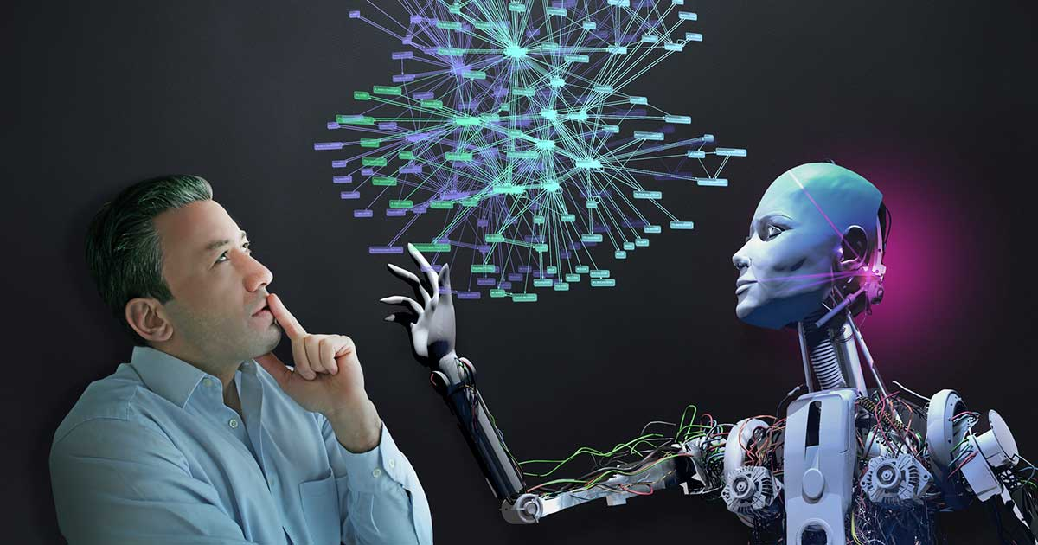
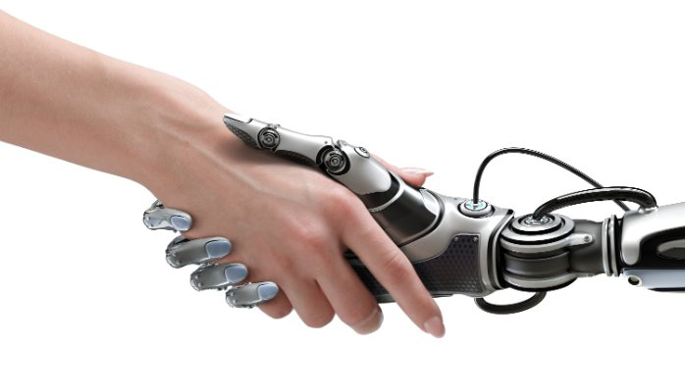
My Research
Facilitating Effective and Efficient Human-Machine Collaboration
to Improve High-Stakes
Decision-Making
Notes:
How do we make ML more effective at high-stakes decision-making?
How can we develop computational methods and tools which enable ML to be effective at
high-stakes decision-making?

Slide 15

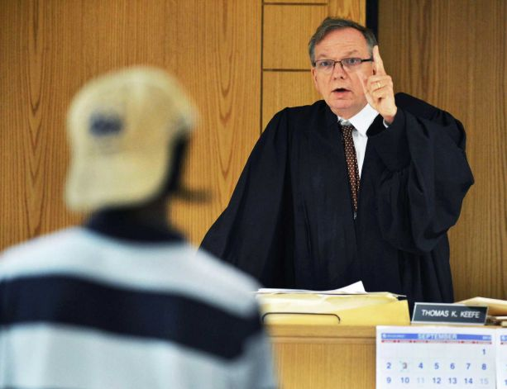
High-Stakes Decisions
Healthcare: What treatment to recommend to the patient?
Criminal Justice: Should the defendant be released on bail?
High-Stakes Decisions: Impact on human well-being.
Notes:
May be consider high-stakes ?
Give bail example

Slide 16





Overview of My Research
Interpretable Models for Decision-Making
Reliable Evaluation
of Models for
Decision-Making
Computational
Methods &
Algorithms
Characterizing Biases in Human & Machine Decisions
Diagnosing Failures of Predictive models
Application
Domains
Law
Healthcare
Education
Business
Notes:
Add blocks like in Jure’s slides
Also highlight what parts you will discuss in detail?
Add details about applications too

Slide 17
Academic Research
Interpretable Models for Decision-Making
[KDD’16, AISTATS’17,
FAT ML’17, AIES’19]
Reliable Evaluation
of Models for
Decision-Making
[QJE’18, KDD’17, KDD’15]
Characterizing Biases in
Human & Machine Decisions
[NIPS’16, SDM’15]
Diagnosing Failures of
Predictive models
[AAAI’17]
Notes:
Add blocks like in Jure’s slides
Also highlight what parts you will discuss in detail?
Add details about applications too

Slide 18
We are Hiring!!
Starting a new, vibrant research group
Focus on ML methods as well as applications
Collaborations with Law, Policy, and Medical schools
PhD, Masters, and Undergraduate students
Background in ML and Programming [preferred]
Computer Science, Statistics, Data Science
Business, Law, Policy, Public Health & Medical Schools
Email me: hlakkaraju@hbs.edu; hlakkaraju@seas.harvard.edu

Slide 19
Questions??

Slide 20


Real World Scenario: Bail Decision
U.S. police make about 12M arrests each year
Release vs. Detain is a high-stakes decision
Pre-trial detention can go up to 9 to 12 months
Consequential for jobs & families of defendants as well as crime
Release/Detain
We consider the
binary decision

Slide 21

Bail Decision
Fail to appear
Non-violent crime
Violent crime
None of the
above
Unfavorable
Release
Favorable
Detain
Spends time in jail
Judge is making a prediction:
Will the defendant commit ‘crime’ if released on bail?
Notes:
Crimes vs. fail to appear (be consistent)

Slide 22
Bail Decision-Making as a Prediction Problem
Build a model that predicts defendant behavior if released based on his/her characteristics
Does making the model more understandable/transparent to the judge improve decision-making performance?
If so, how to do it?
Training examples ⊆ Set of Released Defendants
Training examples
Defendant Characteristics |  |  |  | Outcome
Age | Prev. Crimes | Level of Charge | …
28 | 2 | Felony | … | Crime
14 | 1 | Misd. | … | No Crime
63 | 0 | Misd. | … | No Crime
. | . | . | … | .
. | . | . | … | .
. | . | . | … | .
Learning algorithm
Test case
Predictive
Model
Prediction:
Defendant Characteristics |  |  |  | Outcome
35 | 3 | Felony | . | ?
Crime
(0.83)
Notes:
Clean up the slide a bit more

Slide 23
Our Experiment
If Current-Offense = Felony:
If Prior-Felony = Yes and Prior-Arrests ≥ 1, then Crime
If Crime-Status = Active and Owns-House = No and Has-Kids = No, then Crime
If Prior-Convictions = 0 and College = Yes and Owns-House = Yes, then No Crime
If Current-Offense = Misdemeanor and Prior-Arrests > 1:
If Prior-Jail-Incarcerations = Yes, then Crime
If Has-Kids = Yes and Married = Yes and Owns-House = Yes, then No Crime
If Lives-with-Partner = Yes and College = Yes and Pays-Rent = Yes, then No Crime
If Current-Offense = Misdemeanor and Prior-Arrests ≤ 1:
If Has-Kids = No and Owns-House = No and Moved_10times_5years = Yes, then Crime
If Age ≥ 50 and Has-Kids = Yes, then No Crime
Default: No Crime
Judges were able to make decisions 2.8 times faster and 38% more accurately (compared to no explanation and only prediction) !

Slide 24


Real World Scenario: Treatment Recommendation
Demographics:
Age
Gender
…..
Medical History:
Has asthma?
Other chronic issues?
……
Symptoms:
Severe Cough
Wheezing
……
What treatment should be given?
Options: quick relief drugs (mild),
controller drugs (strong)
Test Results:
Peak flow: Positive
Spirometry: Negative

Slide 25

Treatment Recommendation
Symptoms relieved in
More than a week
Within a week
Unfavorable
User studies showed that doctors were able to make decisions 1.9 times faster and 26% more accurately when explanations were provided along with the model!
mild
Favorable
Symptoms relieved in
Within a week
strong
Doctor is making a prediction:
Will the patient get better with a milder drug?
Use ML to make a similar prediction
Notes:
Crimes vs. fail to appear (be consistent)

Slide 26
Questions??

Slide 27
Interpretable Classifiers Using Rules and Bayesian Analysis
Benjamin Letham, Cynthia Rudin, Tyler McCormick, David Madigan; 2015

Slide 28
Contributions
Goal: Rigorously define and evaluate interpretability
Taxonomy of interpretability evaluation
Taxonomy of interpretability based on applications/tasks
Taxonomy of interpretability based on methods

Slide 29
Motivation for Interpretability
ML systems are being deployed in complex high-stakes settings
Accuracy alone is no longer enough
Auxiliary criteria are important:
Safety
Nondiscrimination
Right to explanation

Slide 30
Motivation for Interpretability
Auxiliary criteria are often hard to quantify (completely)
E.g.: Impossible to enumerate all scenarios violating safety of an autonomous car
Fallback option: interpretability
If the system can explain its reasoning, we can verify if that reasoning is sound w.r.t. auxiliary criteria

Slide 31
Prior Work: Defining and Measuring Interpretability
Little consensus on what interpretability is and how to evaluate it
Interpretability evaluation typically falls into:
Evaluate in the context of an application
Evaluate via a quantifiable proxy

Slide 32
Prior Work: Defining and Measuring Interpretability
Evaluate in the context of an application
If a system is useful in a practical application or a simplified version, it must be interpretable
Evaluate via a quantifiable proxy
Claim some model class is interpretable and present algorithms to optimize within that class
E.g. rule lists
You will know it when you see it!

Slide 33
Lack of Rigor?
Important to formalize these notions!!!
Yes and No
Previous notions are reasonable
However,
Are all models in all “interpretable” model classes equally interpretable?
Model sparsity allows for comparison
How to compare a model sparse in features to a model sparse in prototypes?
Do all applications have same interpretability needs?

Slide 34
What is Interpretability?
Defn: Ability to explain or to present in understandable terms to a human
No clear answers in psychology to:
What constitutes an explanation?
What makes some explanations better than the others?
When are explanations sought?
This Work: Data-driven ways to derive operational definitions and
evaluations of explanations and interpretability

Slide 35
When and Why Interpretability?
Not all ML systems require interpretability
E.g., ad servers, postal code sorting
No human intervention
No explanation needed because:
No consequences for unacceptable results
Problem is well studied and validated well in real-world applications → trust system’s decision
When do we need explanation then?

Slide 36
When and Why Interpretability?
Incompleteness in problem formalization
Hinders optimization and evaluation
Incompleteness ≠ Uncertainty
Uncertainty can be quantified
E.g., trying to learn from a small dataset (uncertainty)

Slide 37
Incompleteness: Illustrative Examples
Scientific Knowledge
E.g., understanding the characteristics of a large dataset
Goal is abstract
Safety
End to end system is never completely testable
Not possible to check all possible inputs
Ethics
Guard against certain kinds of discrimination which are too abstract to be encoded
No idea about the nature of discrimination beforehand

Slide 38
Incompleteness: Illustrative Examples
Mismatched objectives
Often we only have access to proxy functions of the ultimate goals
Multi-objective tradeoffs
Competing objectives
E.g., privacy and prediction quality
Even if the objectives are fully specified, trade-offs are unknown, decisions have to be case by case

Slide 39
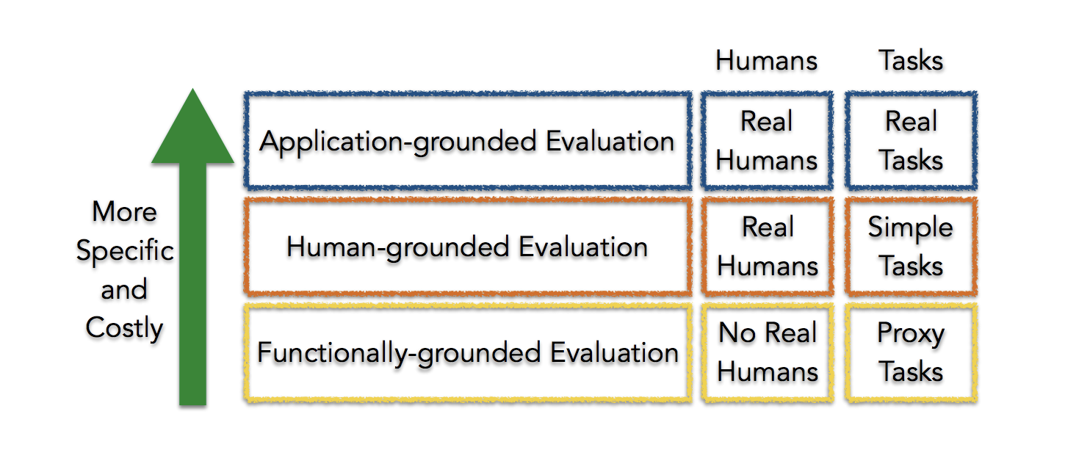
Taxonomy of Interpretability Evaluation
Claim of the research should match the type of the evaluation!

Slide 40
Application-grounded evaluation
Real humans (domain experts), real tasks
Domain expert experiment with exact application task
Domain expert experiment with a simpler of partial task
Shorten experiment time
Increases number of potential subjects
Typical in HCI and visualization communities

Slide 41
Human-grounded evaluation
Real humans, simplified tasks
Can be completed with lay humans
Larger pool, less expensive
More general notions of explainability
Eg., what kinds of explanations are understood under time constraints?
Potential experiments
Pairwise comparisons
Simulate the model output
What changes should be made to input to change the output?

Slide 42
Functionally-grounded evaluation
No humans, proxy tasks
Appropriate for a class of models already validated
Eg., decision trees
A method is not yet mature
Human subject experiments are unethical
What proxies to use?
Potential experiments
Complexity (of a decision tree) compared to other other models of the same (similar) class
How many levels? How many rules?

Slide 43
Open Problems: Design Issues
What proxies are best for what real world applications?
What factors to consider when designing simpler tasks in place of real world tasks?
How about a data-driven approach to characterize interpretability?

Slide 44
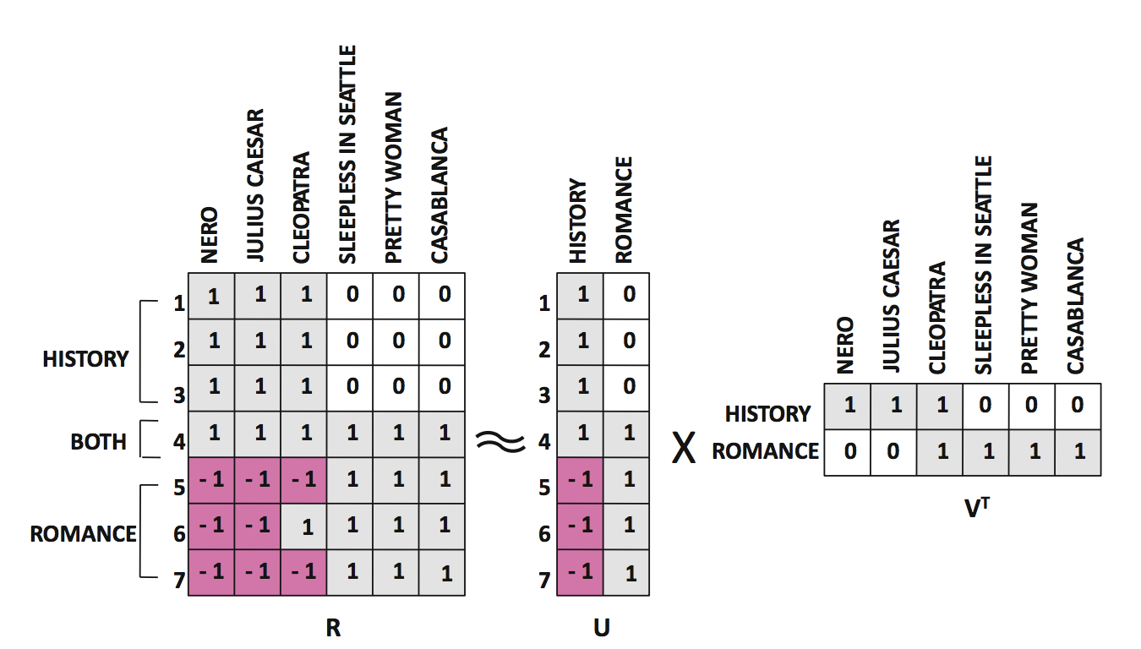
Matrix Factorization: Netflix Problem

Slide 45
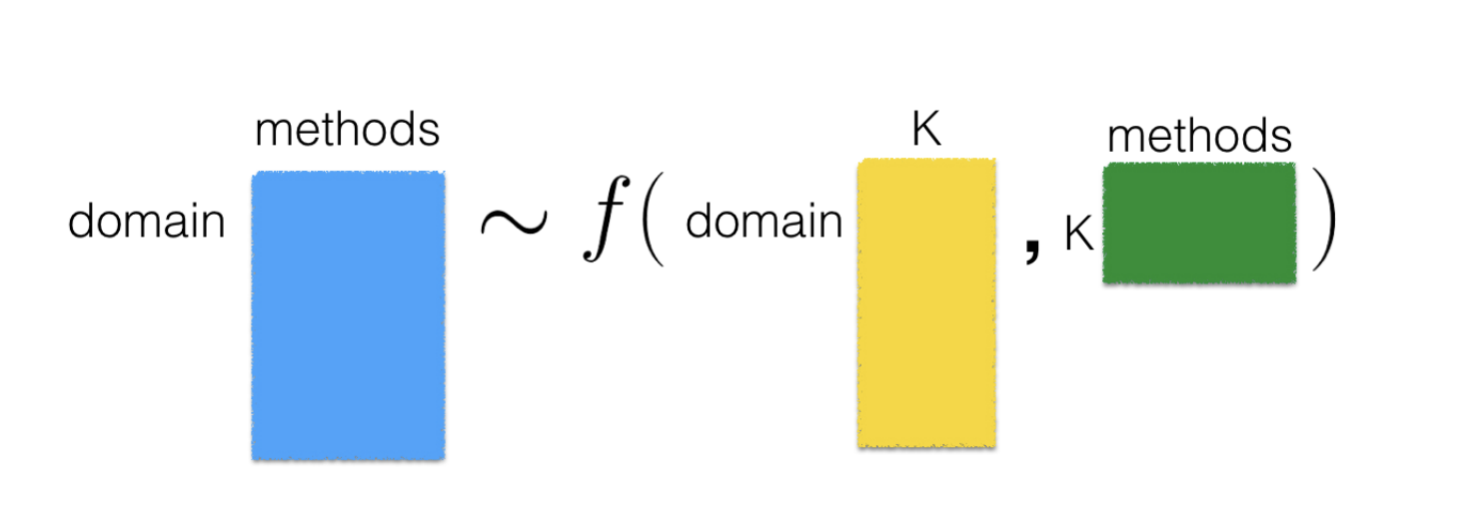
Data-driven approach to characterize interpretability
K is the number of latent dimensions
Matrix on the left is very expensive and time consuming to obtain – requires evaluation in real world applications with domain experts!
So, data-driven approach to characterize interpretability is not feasible!

Slide 46
Taxonomy based on applications/tasks
Global vs. Local
High level patterns vs. specific decisions
Degree of Incompleteness
What part of the problem is incomplete? How incomplete is it?
Incomplete inputs or constraints or costs?
Time Constraints
How much time can the user spend to understand explanation?

Slide 47
Taxonomy based on applications/tasks
Nature of User Expertise
How experienced is end user?
Experience affects how users process information
E.g., domain experts can handle detailed, complex explanations compared to opaque, smaller ones
Note: These taxonomies are constructed based on intuition and are not data or evidence driven. They must be treated as hypotheses.

Slide 48
Taxonomy based on methods
Basic units of explanation:
Raw features? E.g., pixel values
Semantically meaningful? E.g., objects in an image
Prototypes?
Number of basic units of explanation:
How many does the explanation contain?
How do various types of basic units interact?
E.g., prototype vs. feature

Slide 49
Taxonomy based on methods
Level of compositionality:
Are the basic units organized in a structured way?
How do the basic units compose to form higher order units?
Interactions between basic units:
Combined in linear or non-linear ways?
Are some combinations easier to understand?
Uncertainty:
What kind of uncertainty is captured by the methods?
How easy is it for humans to process uncertainty?

Slide 50
Summary
Goal: Rigorously define and evaluate interpretability
Taxonomy of interpretability evaluation
An attempt at data-driven characterization of interpretability
Taxonomy of interpretability based on applications/tasks
Taxonomy of interpretability based on methods

Slide 51
Questions??

Slide 52
Let’s start the critique!

Slide 53
The Mythos of Model Interpretability
Zachary Lipton; 2017

Slide 54
Contributions
Goal: Refine the discourse on interpretability
Outline desiderata of interpretability research
Motivations for interpretability are often diverse and discordant
Identifying model properties and techniques thought to confer interpretability

Slide 55
Motivation
We want models to be not only good w.r.t. predictive capabilities, but also interpretable
Interpretation is underspecified
Lack of a formal technical meaning
Papers provide diverse and non-overlapping motivations for interpretability

Slide 56
Prior Work: Motivations for Interpretability
Interpretability promotes trust
But what is trust?
Is it faith in model performance?
If so, why are accuracy and other standard performance evaluation techniques inadequate?

Slide 57
When is interpretability needed?
Simplified optimization objectives fail to capture complex real life goals.
Algorithm for hiring decisions – productivity and ethics
Ethics is hard to formulate
Training data is not representative of deployment environment
Interpretability serves those objectives that we deem important
but struggle to model formally!

Slide 58
Desiderata
Understanding motivations for interpretability through the lens of prior literature
Trust
Causality
Transferability
Informativeness
Fair and Ethical Decision Making

Slide 59
Desiderata: Trust
Is trust simply confidence that the model will perform well?
If so, interpretability serves no purpose
A person might feel at ease with a well understood model, even if this understanding has no purpose
Training and deployment objectives diverge
Eg., model makes accurate predictions but not validated for racial biases
Trust → relinquish control
For which examples is the model right?

Slide 60
Desiderata: Causality
Researchers hope to infer properties (beyond correlational associations) from interpretations/explanations
Regression reveals strong association between smoking and lung cancer
However, task of inferring causal relationships from observational data is a field in itself
Don Rubin
Judea Pearl

Slide 61
Desiderata: Transferability
Humans exhibit richer capacity to generalize, transferring learned skills to unfamiliar situations
Model’s generalization error: gap between performance on training and test data
We already use ML in non-stationary environments
Environment might even be adversarial
Changing pixels in an image tactically could throw off models but not humans
Predictive models can often be gamed
In such cases, predictive power loses meaning
Notes:
Number of accounts → pay a debt or not

Slide 62
Desiderata: Informativeness
Predictions → Decisions
Convey additional information to human decision makers
Example: Which conference should I target?
A one word answer is not very meaningful
Interpretation might be meaningful even if it does not shed light on model’s inner workings
Similar cases for a doctor in support of a decision

Slide 63
Desiderata: Fair & Ethical Decision Making
ML is being deployed in critical settings
Eg., Bail and recidivism predictions
How can we be sure algorithms do not discriminate on the basis of race?
AUC is not good enough
Side note: European Union – Right to explanation

Slide 64
Properties of Interpretable Models
Transparency
How exactly does the model work?
Details about its inner workings, parameters etc.
Post-hoc explanations:
What else can the model tell me?
Eg., visualizations of learned model, explaining by example

Slide 65
Transparency: Simulatability
Can a person contemplate the entire model at once?
Need a very simple model
A human should be able to take input data and model parameters and calculate prediction
Simulatability: size of the model + computation required to perform inference
Decision trees: size of the model may grow faster than time to perform inference

Slide 66
Transparency: Decomposability
Understanding each input, parameter, calculation
Eg., decision trees, linear regression
Inputs must be interpretable
Models with highly engineered or anonymous features are not decomposable

Slide 67
Algorithmic Transparency
Learning algorithm itself is transparent
Eg., linear models (error surface, unique solution)
Modern deep learning methods lack this kind of transparency
We don’t understand how the optimization methods work
No guarantees of working on new problems
Note: Humans do not exhibit any of these forms of transparency

Slide 68
Post-hoc: Text Explanations
Humans often justify decisions verbally (post-hoc)
Krening et. al.:
One model is a reinforcement learner
Another model maps models states onto verbal explanations
Explanations are trained to maximize likelihood of ground truth explanations from human players
So, explanations do not faithfully describe agent decisions, but rather human intuition

Slide 69
Post-hoc: Visualization
Visualize high-dimensional data with t-SNE
2D visualizations in which nearby data points appear close
Perturb input data to enhance activations of certain nodes in neural nets (image classification)
Helps understand which nodes corresponds to what aspects of the image
Eg., certain nodes might correspond to dog faces

Slide 70
Post-hoc: Example Explanations
Reasoning with examples
Eg., Patient A has a tumor because he is similar to these k other data points with tumors
k neighbors can be computed by using some distance metric on learned representations
Eg., word2vec

Slide 71
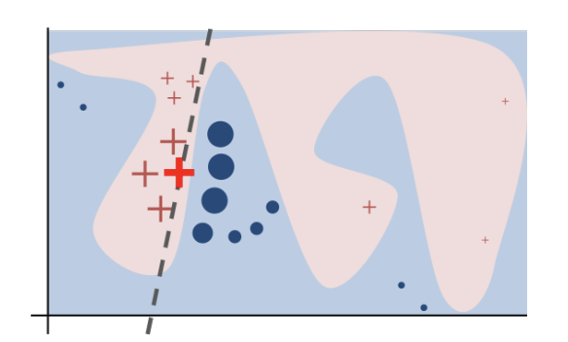
Post-hoc: Local Explanations
Hard to explain a complex model in its entirety
How about explaining smaller regions?
Explains decisions of any model in a local region around a particular point
Learns sparse linear model
LIME (Ribeiro et. al.)

Slide 72
Claims about interpretability must be qualified
If a model satisfies a form of transparency, highlight that clearly
For post-hoc interpretability, fix a clear objective and demonstrate evidence

Slide 73
Transparency may be at odds with broader objectives of AI
Choosing interpretable models over accurate ones to convince decision makers
Short term goal of building trust with doctors might clash with long term goal of improving health care

Slide 74
Post-hoc interpretations can mislead
Do not blindly embrace post-hoc explanations!
Post-hoc explanations can seem plausible but be misleading
They do not claim to open up the black-box;
They only provide plausible explanations for its behavior
Eg., text explanations

Slide 75
Are linear models always more transparent than deep neural networks?
Read 4.1 [Lipton] and write a paragraph on canvas.
Must cover different perspectives on transparency: simulatability, decomposability, and algorithmic transparency
Due September 10th (Tuesday) 11.59pm ET

Slide 76
Summary
Goal: Refine the discourse on interpretability
Outline desiderata of interpretability research
Motivations for interpretability are often diverse and discordant
Identifying model properties and techniques thought to confer interpretability

Slide 77
Takeaways
Interpretability is often desired when there is
Incompleteness
Mismatch between training and deployment environments
There is no single definition of interpretability that caters to all needs
Build reliable taxonomies
Build unified terminology

Slide 78
Questions??

Slide 79
Let’s start the critique!

Slide 80
Things to do!
To apply for course enrollment, please fill out https://forms.gle/2cmGx3469zKyJ6DH9 by September 7th 11.59pm ET
Readings for next week (empirical studies)
An Evaluation of the Human-Interpretability of Explanation
Manipulating and Measuring Model Interpretability
What do you like/dislike about each paper? Why?
Any questions? – post on canvas before next lecture
Please be prepared for class discussions!
Start thinking about project proposals
Come talk to us during office hours
Note: Checkpoint 1 due on 09/23

Slide 81
Course Participation Credit - Today
Are linear models always more transparent than deep neural networks?
[Due September 10th 11.59pm ET]
Read 4.1 [Lipton] and write a paragraph on canvas.
Must cover different perspectives on transparency: simulatability, decomposability, and algorithmic transparency

Slide 82
Upcoming Deadlines
Checkpoint 1: Project proposals due 09/23
September 16th -- HW1 released
Refresher for your ML concepts – SVMs, Neural Networks, Regression, Unsupervised Learning, EM Algorithm
2 weeks to finish
Please check course webpage regularly!

Slide 83
Relevant Conferences to Explore
ICML
NeurIPS
ICLR
UAI
AISTATS
KDD
AAAI
FAT*
AIES

Slide 84
Questions??

